Slide 1
Scrum Rituals Sprint Demo

Slide 2
Week 5 Summary
Roles | Rituals | Artifacts
Scrum Master Product Owner Development Team | Sprint Planning Daily Standup Sprint Demo Sprint Retrospective | Story Product backlog Sprint backlog Scrum board Definition of "done“ Velocity charts Burndown chart Product increment

Slide 3
Week 6 Overview
Roles | Rituals | Artifacts
Scrum Master Product Owner Development Team | Sprint Planning Daily Standup Sprint Demo Sprint Retrospective | Story Product backlog Sprint backlog Scrum board Definition of "done“ Velocity charts Burndown chart Product increment

Slide 4
One- Week Sprint Ritual
(2) Daily Standup
Development
Daily Standup
Development
Daily Standup
Development
(3) Sprint Demo
(4) Sprint Retrospective
(1) Sprint Planning
Development

Slide 5
Sprint Demo - Objective
at the end of the sprint, demonstrate everything
is to get a clear picture of how much work has been completed during the sprint, and to see what the current state of the product will be after integrating the work that was done during the sprint
team learns more about how many points they can sustainably accomplish in a single sprint, and this improves their ability to estimate stories and sprint backlogs going forward

Slide 6
Sprint Demo - Time Box
contingent on the number of stories completed during the sprint, and the level of intricacy associated with the acceptance criteria
half a day for the sprint demo if they're using a two week sprint
scrum master should be responsible for making sure that everything that needs to happen fits within that time box

Slide 7
Sprint Demo - Preparation
Each person who has worked on any stories that are ready to demo needs to be prepared to explain what they did with those stories
Product owner
will meet engineers before demo to make sure everybody is aware of what's going to be presented
useful last step before the demo to ensure the stories presented meet all of the acceptance criteria.
reminds the engineers to make any preparations necessary to allow unreleased stories to be demonstrated.

Slide 8
Sprint Demo - Preparation
scrum master
meet with all engineers who have stories completed, to make sure these stories are prepared for the demo

Slide 9
Sprint Demo – (a) Demonstrating a Story
consistent
product owner
read the story—as well as any major acceptance criteria—to the team while the demo is being set up
everybody will know what to look for
will be aware of issues that might come up
scrum master
go through each story on the list, and have the engineers set up the demo for the team

Slide 10
Sprint Demo – (a) Demonstrating a Story
the state of the product is the main focus of attention
each story should be a complete slice of functionality added to the product
the demo should show that slice of functionality in context with the actual product.
The demo should walk through each of the acceptance criteria, proving that they have been met.

Slide 11
Sprint Demo – (a) Demonstrating a Story
If it's realized that the acceptance criteria as they were originally written were inadequate
may not have covered all the cases the product owner needed addressed.
If this happens, keep in mind that a demo that meets all of the acceptance criteria—as they were specified in a story that was estimated at the sprint planning—should be considered accepted and done
Any further changes that may be needed are new stories

Slide 12
Sprint Demo – (b) Tallying up the Points
At the end of the demo
a number of stories will have been accepted
Scrum master
add up the number of points completed during the sprint, based solely on the estimated points assigned to stories that were accepted as done
The total number of points completed in the sprint should be recorded as the team's velocity for that sprint

Slide 13
Sprint Demo – (b) Tallying up the Points
Some stories may have been rejected, or may not have been ready to demo despite being included in the sprint backlog.
Product owner
decides whether stories that weren't completed will be added to the next sprint, or put on hold pending a possible future sprint
Scrum master
keeps track of all the stories, both completed and not yet completed, and update their status in any tracking tools that the team may be using
generate a set of reports that are sent out at the end of the sprint demo, updating interested parties about the status of the product

Slide 14
Sprint Demo – (c) Releasing the Stories
process that takes completed features and integrates them into the live product, either so the users can have access to them immediately, or so they can be evaluated for inclusion in a future release
process may be overseen by release engineers, or integrated at the developer level with a set of fail-safes and rollback procedures

Slide 15
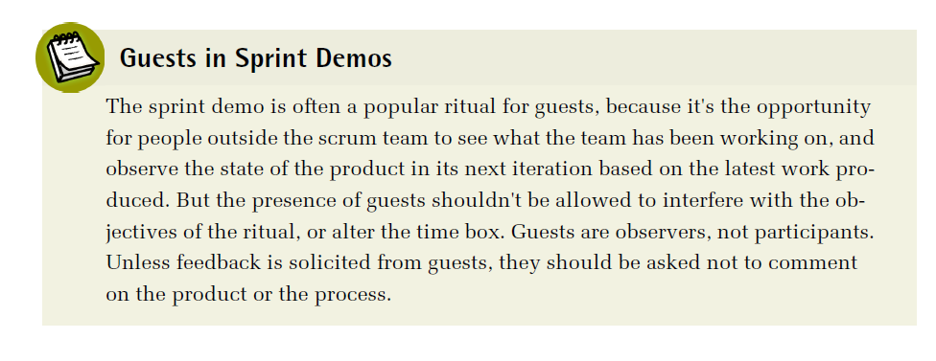

Slide 16
Scrum Framework - Overview
Roles | Rituals | Artifacts
Scrum Master Product Owner Development Team | Sprint Planning Daily Standup Sprint Demo Sprint Retrospective | Story Product backlog Sprint backlog Scrum board Definition of "done“ Velocity charts Burndown chart Product increment

Slide 17
Scrum Artifacts - Product Increment
the completed features at end of sprint, added to the product for the sprint demo
the product itself is an artifact of the scrum process.
product increment
develop features in such a way that the product is in a completed state at the end of every sprint
to released, demonstrated to clients for feedback, or used as a tool for testing

Slide 18
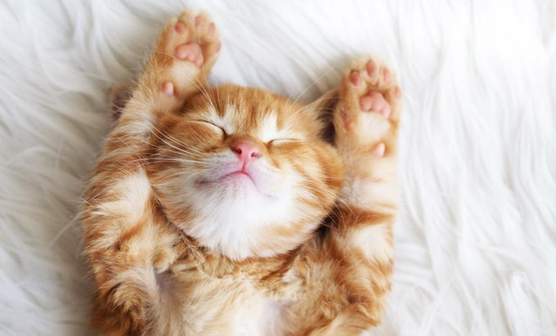
Scrum Example - WithKittens
How Scrum Works

Slide 19
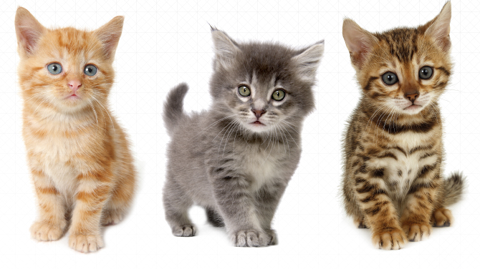
Recap Story Background

Slide 20
Scrum Process Example - WithKittens
WithKittens team
six engineers
image processing specialists
back-end data processing
API management engineers
front-end engineers for both web and mobile interfaces
billing and security experts
one product owner
product management for both desktop and web applications
one scrum master
working together for about three years

Slide 21
Scrum Process Example - WithKittens
Other members
dedicated designer on the design team
a pair of QA engineers
a small team of DevOps engineers
site running and also handle IT issues

Slide 22
Scrum Process Example - WithKittens
unique facets of the service
figuring out the ideal positioning of kittens in pictures
best ways to optimize images for proper delivery

Slide 23
Why Just Kittens?
founder and CEO of the company has a long history of working with cat rescue societies
idea for the service began as something to support one local nonprofit organization, and grew quickly as other nonprofits
users decided they also wanted to be able to add kittens to their pictures

Slide 24
Scrum Process Example - WithKittens
produce both a website and a mobile application designed to add pictures of kittens to any image uploaded by their clients
free tier customers (most)
adding kittens to their own social media images and sharing them
paying customers (some)
for the privilege of knowing only the very best kittens will be added to their images consistently and reliably
great deal more control over the quality and content than free users get
high-end social media users
people who want more control over the way their kittens are presented in their pictures
growing business clientele, including companies who use theWithKittens service to add appeal
important to keep paying clients happy

Slide 25
Problem at Kitten Haven
the company's focus on kitten-only content has never been a serious issue before
but recently, the company's largest clients, a multinational marketing conglomerate were planning to switch contracts to a competitor. They puppy images

Slide 26
CEO & Product Owner
Meeting between CEO and product owner
value of adapting to changing market expectations
the appropriateness of adding a service that conflicts with the historical intent of the company
conflict with company name
decided to work on puppy-friendly features
keeping in mind are the overhead of maintaining an entirely independent service versus the cost of developing and supporting an integrated service
scheduled to work on next

Slide 27
So far….
Team completed Sprint Planning
Already prepared
Scrum Board
Product Backlog
Stories
Sprint Backlog
Team ran Daily Standup for Sprint 11
Team completed Sprint 11 (one week scrum sprint)
Next step -> Sprint Demo

Slide 28
Demonstrating the Story
A day before the demo, as part of the preparation, the product owner sits down with the junior engineer who owns the puppy story
product owner wants to be sure all of the acceptance criteria can be demonstrated

Slide 29
Demonstrating the Story
product owner: Will we have this staged properly on production-ready servers in time for the demo?
Jr Engineer: Pretty much. That's the server QA has been testing on. It should be fine for the demo
product owner: Do I need to know anything special or can I just go to the same server we're using right now?
Jr Engineer: We shouldn't need to set up anything custom. I think you've been through the components a few times already. Once it's deployed, you should be able to join the beta, test the features, and then exit the beta successfully."

Slide 30
Demonstrating the Story
product owner: Can I go through the whole thing right now?
Jr Engineer: Not yet but QA has passed on everything, so we just need to go through deployment before tomorrow. It should be ready in time for the demo
product owner: Great, I'm looking forward to seeing it

Slide 31
Demonstrating the Story
Scrum Board at Demo

Slide 32
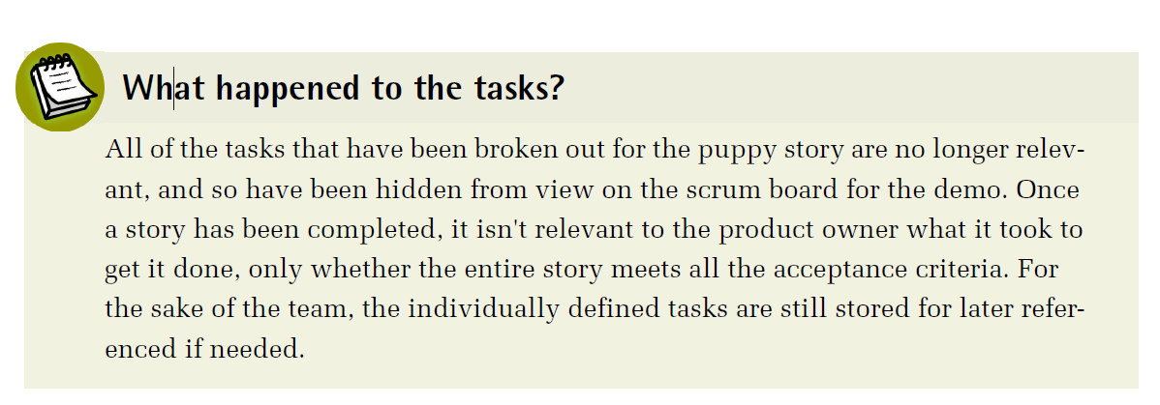

Slide 33
Demonstrating the Story
product owner
verify that the stories carried over from the previous sprint are now completed
Demo of Puppy Story
product owner: So, how do I get into the beta?
Jr Engineer: You should have a sample invitation email with a link to join the beta. Check your inbox, and click the link to get started.
Product Owner checks out beta site

Slide 34
Demonstrating the Story
product owner: So far it looks pretty good
Engineer 1: We had to take some liberties with the formatting in the header to accommodate the help integration. I don't think the solution is ideal, but it does get the job done
product owner: Yeah, let's check that out now.
Engineer 1: That seemed to be the best way to get the information you needed up on the screen where people might expect to find it. If we had had time to do the full refactor, we could have integrated it directly into the help topics, but there just wasn't time to do it with the code the way it was

Slide 35
Demonstrating the Story
product owner: That doesn't look great, but I see where you're coming from
Designer: I think we can come up with some more elegant ways to do that. I can work on some sketches.
product owner: That would be good. I really don't want to send it out looking like this.
scrum master: But it does meet the acceptance criteria, right?
product owner: Yeah. So if we do want to do updates for the visual design, that'll be a new story for the next sprint, right?
scrum master: That's what it sounds like

Slide 36
Demonstrating the Story
product owner
Goes through all of the acceptance criteria
identifies a number of areas where there's room for improvement
Make choices on visual layout
Team
consider the story completed
but not ready for production release
scrum master
updates the story on the scrum board

Slide 37
Scrum Broad – End of Sprint 11

Slide 38
To be continued…

Slide 39
Week 6 Summary
Roles | Rituals | Artifacts
Scrum Master Product Owner Development Team | Sprint Planning Daily Standup Sprint Demo Sprint Retrospective | Story Product backlog Sprint backlog Scrum board Definition of "done“ Velocity charts Burndown chart Product increment

